Slide 1

FBI
TECHNOLOGY
WHITE COLLAR
EJB IBM WebSphere Object - Enterprise
1 WEBSERVICE
1 EJB cluster rmi-iiop://
? database
Vice President Germany
Al Kaida, RAF
Dr. Prof Juregen Zimmann
Ports Authority Hamburg
ONE (EJB)
Book
HQ: New York, Armonk
Satellite: California, San Francisco
Cluster rmi-iiop:
ejb://nonPoliceEmployeeEJB
POJO
Plain old Java Object
MANY
SQ
2007 ibm.damielr.emplye.viging.romeeti
2007 Ibm.dmier.amazon.jeff.bezos
JESUS ibm.dmiler.apple.employe.juesue.rodriguz
JESUS ibm.demri.apple.accnetuer.touch.greenstamps.employee.?.?
….

Slide 2


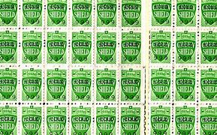

FBI
TECHNOLOGY
WHITE COLLAR
Ibm.daimler.apple.accntuer.touch
2007/8
JESUS ibm.demri.apple.accnetuer.touch.greenstamps.employee.?.?
PRESENTATION
ibm.dmiler.appe.accneure.touch.greenstamps.employe.sabry.tozin: He is using POJO
1D8723: What is POJO?
ibm.dmiler.appe.accneure.touch.greenstamps.employe.sabry.tozin: Plan old objects on tomcat
Ibm.daimler.apple.accntuer.touch.greenstamps

